Slide 1
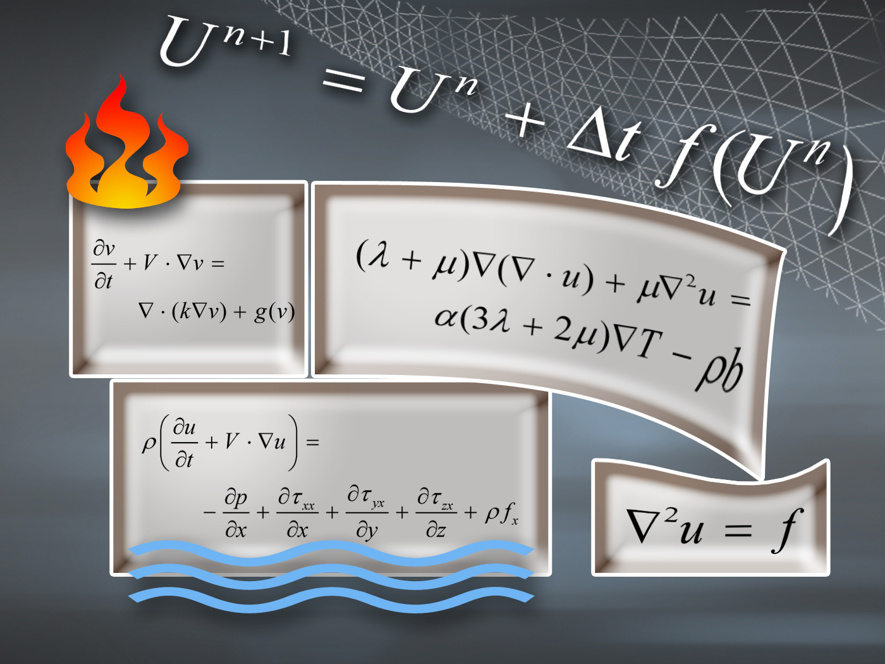
NUMERICAL METHODS
Lecture 3E
Dr. P V Ramana
NM Dr P V Ramana

Slide 2
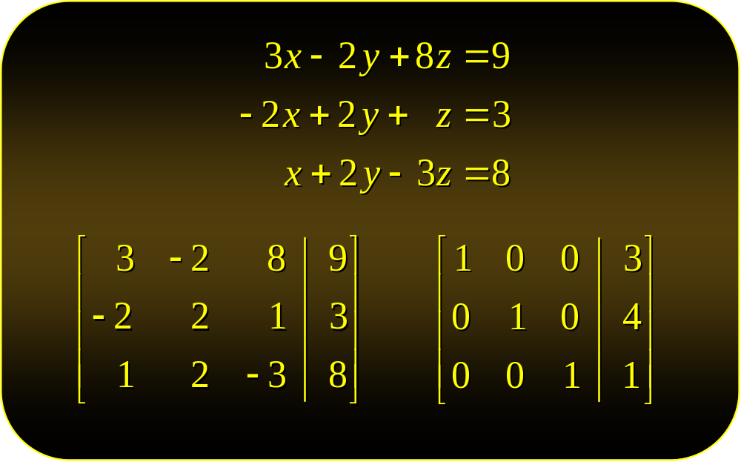
Systems of Linear Equations:
Unique Solutions
NM Dr P V Ramana

Slide 3
The Gauss-Jordan Method
The Gauss-Jordan elimination method is a technique for solving systems of linear equations of any size.
The operations of the Gauss-Jordan method are
  Interchange any two equations.
  Replace an equation by a nonzero constant multiple of itself.
  Replace an equation by the sum of that equation and a constant multiple of any other equation.
NM Dr P V Ramana

Slide 4
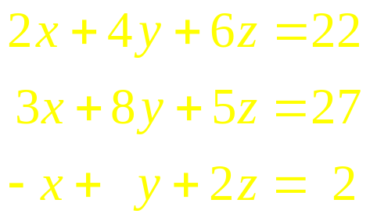
Example
Solve the following system of equations:
Solution
First, transform this system into an equivalent system in which the coefficient of x in the first equation is 1:
Toggle slides back and forth to compare before and changes
Multiply the equation by 1/2
NM Dr P V Ramana

Slide 5
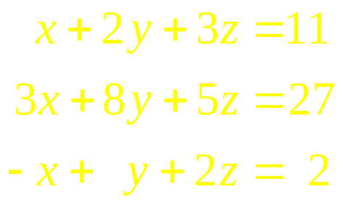
Example
Solve the following system of equations:
Solution
First, transform this system into an equivalent system in which the coefficient of x in the first equation is 1:
Toggle slides back and forth to compare before and changes
Multiply the first equation by 1/2
NM Dr P V Ramana

Slide 6
Example
Solve the following system of equations:
Solution
Next, eliminate the variable x from all equations except the first:
Toggle slides back and forth to compare before and changes
Replace by the sum of – 3 X the first equation + the second equation
NM Dr P V Ramana

Slide 7
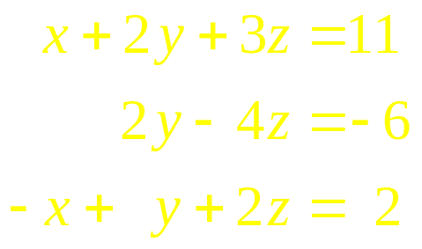
Example
Solve the following system of equations:
Solution
Next, eliminate the variable x from all equations except the first:
Toggle slides back and forth to compare before and changes
Replace by the sum of – 3 ☓ the first equation + the second equation
NM Dr P V Ramana

Slide 8
Example
Solve the following system of equations:
Solution
Next, eliminate the variable x from all equations except the first:
Toggle slides back and forth to compare before and changes
Replace by the sum of the first equation + the third equation
NM Dr P V Ramana

Slide 9
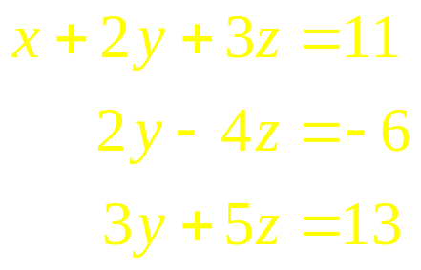
Example
Solve the following system of equations:
Solution
Next, eliminate the variable x from all equations except the first:
Toggle slides back and forth to compare before and changes
Replace by the sum of the first equation + the third equation
NM Dr P V Ramana

Slide 10
Example
Solve the following system of equations:
Solution
Then transform so that the coefficient of y in the second equation is 1:
Toggle slides back and forth to compare before and changes
Multiply the second equation by 1/2
NM Dr P V Ramana

Slide 11
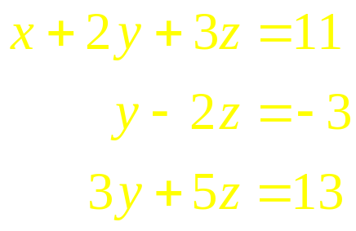
Example
Solve the following system of equations:
Solution
Then transform so that the coefficient of y in the second equation is 1:
Toggle slides back and forth to compare before and changes
Multiply the second equation by 1/2
NM Dr P V Ramana

Slide 12
Example
Solve the following system of equations:
Solution
now eliminate y from all equations except the second:
Toggle slides back and forth to compare before and changes
Replace by the sum of the first equation + (–2) ☓ the second equation
NM Dr P V Ramana

Slide 13
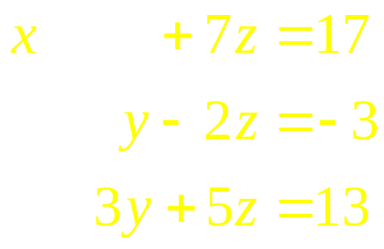
Example
Solve the following system of equations:
Solution
now eliminate y from all equations except the second:
Toggle slides back and forth to compare before and changes
Replace by the sum of the first equation + (–2) ☓ the second equation
NM Dr P V Ramana

Slide 14
Example
Solve the following system of equations:
Solution
now eliminate y from all equations except the second:
Toggle slides back and forth to compare before and changes
Replace by the sum of the third equation + (–3) ☓ the second equation
NM Dr P V Ramana

Slide 15
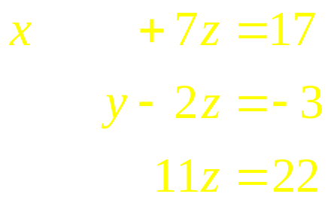
Example
Solve the following system of equations:
Solution
now eliminate y from all equations except the second:
Toggle slides back and forth to compare before and changes
Replace by the sum of the third equation + (–3) ☓ the second equation
NM Dr P V Ramana

Slide 16
Example
Solve the following system of equations:
Solution
Now transform so that the coefficient of z in the third equation is 1:
Toggle slides back and forth to compare before and changes
Multiply the third equation by 1/11
NM Dr P V Ramana

Slide 17
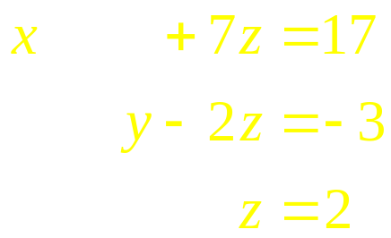
Example
Solve the following system of equations:
Solution
Now transform so that the coefficient of z in the third equation is 1:
Toggle slides back and forth to compare before and changes
Multiply the third equation by 1/11
NM Dr P V Ramana

Slide 18
Example
Solve the following system of equations:
Solution
now eliminate z from all equations except the third:
Toggle slides back and forth to compare before and changes
Replace by the sum of the first equation + (–7) ☓ the third equation
NM Dr P V Ramana

Slide 19
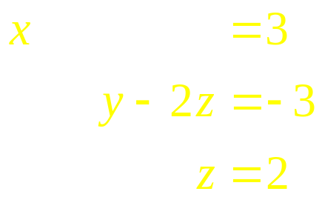
Example
Solve the following system of equations:
Solution
now eliminate z from all equations except the third:
Toggle slides back and forth to compare before and changes
Replace by the sum of the first equation + (–7) ☓ the third equation
NM Dr P V Ramana

Slide 20
Example
Solve the following system of equations:
Solution
now eliminate z from all equations except the third:
Toggle slides back and forth to compare before and changes
Replace by the sum of the second equation + 2 ☓ the third equation
NM Dr P V Ramana

Slide 21
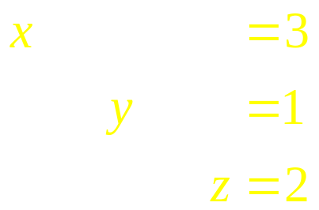
Example
Solve the following system of equations:
Solution
now eliminate z from all equations except the third:
Toggle slides back and forth to compare before and changes
Replace by the sum of the second equation + 2 ☓ the third equation
NM Dr P V Ramana

Slide 22
Example
Solve the following system of equations:
Solution
Thus, the solution to the system is x = 3, y = 1, and z = 2.
NM Dr P V Ramana

Slide 23
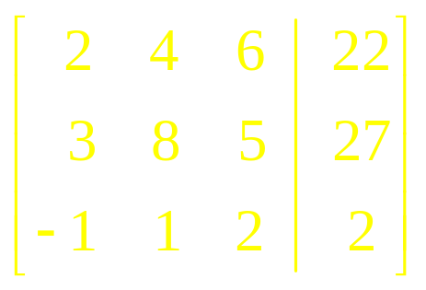
Augmented Matrices
Matrices are rectangular arrays of numbers that can aid us by eliminating the need to write the variables at each step of the reduction.
For example, the system
may be represented by the augmented matrix
Coefficient Matrix
NM Dr P V Ramana

Slide 24
Matrices and Gauss-Jordan
Every step in the Gauss-Jordan elimination method can be expressed with matrices, rather than systems of equations, thus simplifying the whole process:
Steps expressed as systems of equations:
Steps expressed as augmented matrices:
Toggle slides back and forth to compare before and changes
NM Dr P V Ramana

Slide 25
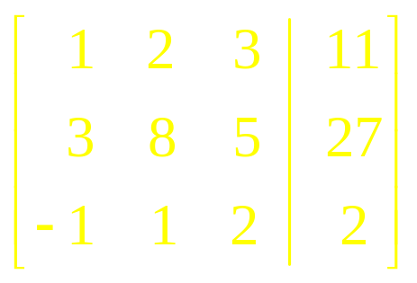
Matrices and Gauss-Jordan
Every step in the Gauss-Jordan elimination method can be expressed with matrices, rather than systems of equations, thus simplifying the whole process:
Steps expressed as systems of equations:
Steps expressed as augmented matrices:
Toggle slides back and forth to compare before and changes
NM Dr P V Ramana

Slide 26
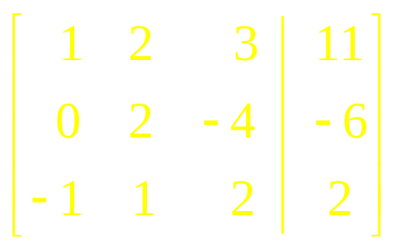
Matrices and Gauss-Jordan
Every step in the Gauss-Jordan elimination method can be expressed with matrices, rather than systems of equations, thus simplifying the whole process:
Steps expressed as systems of equations:
Steps expressed as augmented matrices:
Toggle slides back and forth to compare before and changes
NM Dr P V Ramana

Slide 27
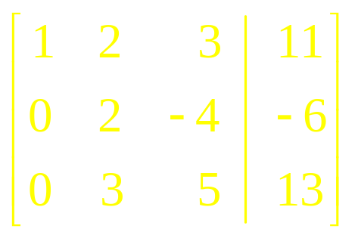
Matrices and Gauss-Jordan
Every step in the Gauss-Jordan elimination method can be expressed with matrices, rather than systems of equations, thus simplifying the whole process:
Steps expressed as systems of equations:
Steps expressed as augmented matrices:
Toggle slides back and forth to compare before and changes
NM Dr P V Ramana

Slide 28
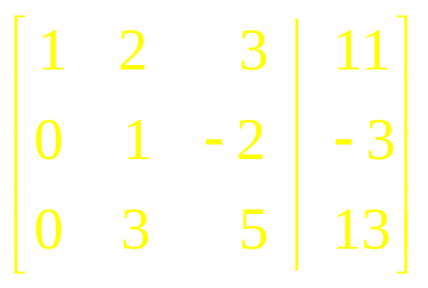
Matrices and Gauss-Jordan
Every step in the Gauss-Jordan elimination method can be expressed with matrices, rather than systems of equations, thus simplifying the whole process:
Steps expressed as systems of equations:
Steps expressed as augmented matrices:
Toggle slides back and forth to compare before and changes
NM Dr P V Ramana

Slide 29
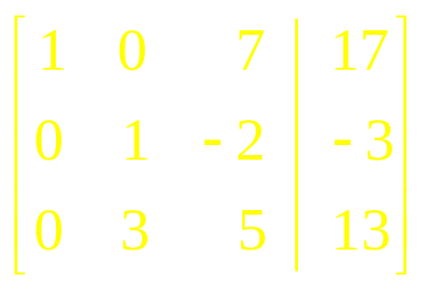
Matrices and Gauss-Jordan
Every step in the Gauss-Jordan elimination method can be expressed with matrices, rather than systems of equations, thus simplifying the whole process:
Steps expressed as systems of equations:
Steps expressed as augmented matrices:
Toggle slides back and forth to compare before and changes
NM Dr P V Ramana

Slide 30
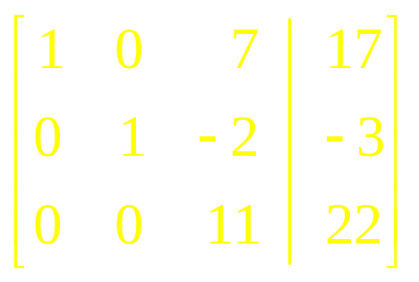
Matrices and Gauss-Jordan
Every step in the Gauss-Jordan elimination method can be expressed with matrices, rather than systems of equations, thus simplifying the whole process:
Steps expressed as systems of equations:
Steps expressed as augmented matrices:
Toggle slides back and forth to compare before and changes
NM Dr P V Ramana

Slide 31
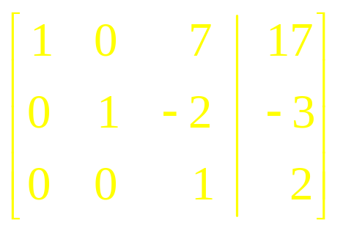
Matrices and Gauss-Jordan
Every step in the Gauss-Jordan elimination method can be expressed with matrices, rather than systems of equations, thus simplifying the whole process:
Steps expressed as systems of equations:
Steps expressed as augmented matrices:
Toggle slides back and forth to compare before and changes
NM Dr P V Ramana

Slide 32
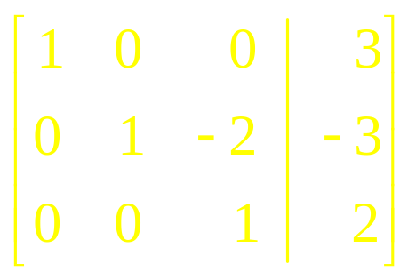
Matrices and Gauss-Jordan
Every step in the Gauss-Jordan elimination method can be expressed with matrices, rather than systems of equations, thus simplifying the whole process:
Steps expressed as systems of equations:
Steps expressed as augmented matrices:
Toggle slides back and forth to compare before and changes
NM Dr P V Ramana

Slide 33
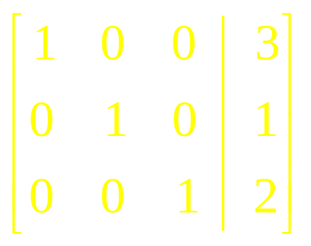
Matrices and Gauss-Jordan
Every step in the Gauss-Jordan elimination method can be expressed with matrices, rather than systems of equations, thus simplifying the whole process:
Steps expressed as systems of equations:
Steps expressed as augmented matrices:
Toggle slides back and forth to compare before and changes
Row Reduced Form of the Matrix
NM Dr P V Ramana

Slide 34
Row-Reduced Form of a Matrix
Each row consisting entirely of zeros lies below all rows having nonzero entries.
The first nonzero entry in each nonzero row is 1 (called a leading 1).
In any two successive (nonzero) rows, the leading 1 in the lower row lies to the right of the leading 1 in the upper row.
If a column contains a leading 1, then the other entries in that column are zeros.
NM Dr P V Ramana

Slide 35
Row Operations
Interchange any two rows.
Replace any row by a nonzero constant multiple of itself.
Replace any row by the sum of that row and a constant multiple of any other row.
NM Dr P V Ramana

Slide 36
Terminology for the
Gauss-Jordan Elimination Method
Unit Column
A column in a coefficient matrix is in unit form if one of the entries in the column is a 1 and the other entries are zeros.
Pivoting
The sequence of row operations that transforms a given column in an augmented matrix into a unit column.
NM Dr P V Ramana

Slide 37
Notation for Row Operations
Letting R_{i} denote the ith row of a matrix, write
  Operation 1: R_{i} ↔ R_{j} to mean:
  Interchange row i with row j.
  Operation 2: cR_{i} to mean:
  replace row i with c times row i.
  Operation 3: R_{i} + aR_{j} to mean:
  Replace row i with the sum of row i and a times row j.
NM Dr P V Ramana

Slide 38
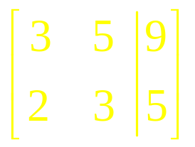

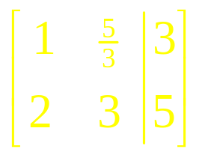

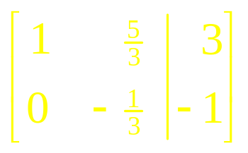
Example
Pivot the matrix about the circled element
Solution
NM Dr P V Ramana

Slide 39
The Gauss-Jordan Elimination Method
Write the augmented matrix corresponding to the linear system.
Interchange rows, if necessary, to obtain an augmented matrix in which the first entry in the first row is nonzero. Then pivot the matrix about this entry.
Interchange the second row with any row below it, if necessary, to obtain an augmented matrix in which the second entry in the second row is nonzero. Pivot the matrix about this entry.
Continue until the final matrix is in row-reduced form.
NM Dr P V Ramana

Slide 40
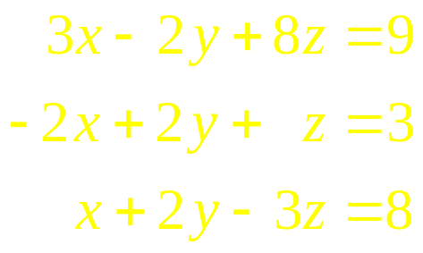
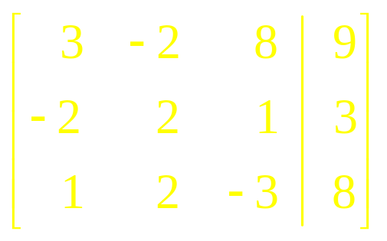

Example
Use the Gauss-Jordan elimination method to solve the system of equations
Solution
Toggle slides back and forth to compare before and after matrix changes
NM Dr P V Ramana

Slide 41
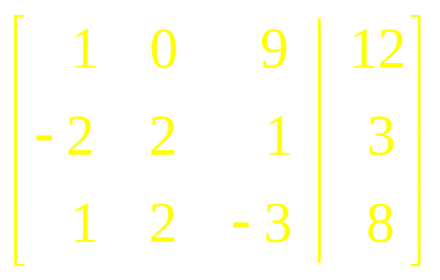


Example
Use the Gauss-Jordan elimination method to solve the system of equations
Solution
Toggle slides back and forth to compare before and after matrix changes
NM Dr P V Ramana

Slide 42
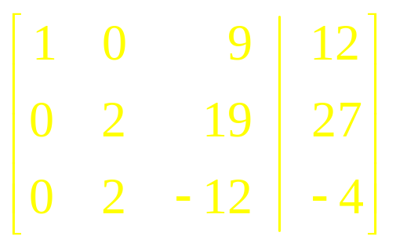

Example
Use the Gauss-Jordan elimination method to solve the system of equations
Solution
Toggle slides back and forth to compare before and after matrix changes
NM Dr P V Ramana

Slide 43
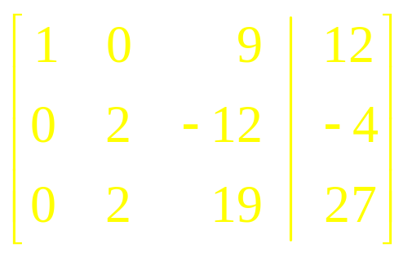

Example
Use the Gauss-Jordan elimination method to solve the system of equations
Solution
Toggle slides back and forth to compare before and after matrix changes
NM Dr P V Ramana

Slide 44
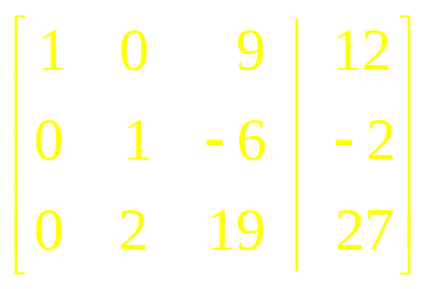

Example
Use the Gauss-Jordan elimination method to solve the system of equations
Solution
Toggle slides back and forth to compare before and after matrix changes
NM Dr P V Ramana

Slide 45
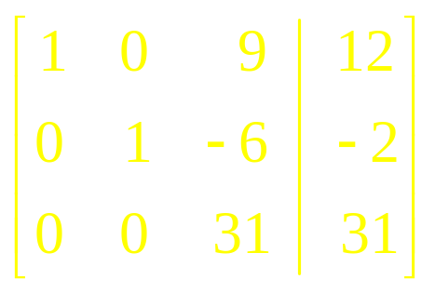

Example
Use the Gauss-Jordan elimination method to solve the system of equations
Solution
Toggle slides back and forth to compare before and after matrix changes
NM Dr P V Ramana

Slide 46
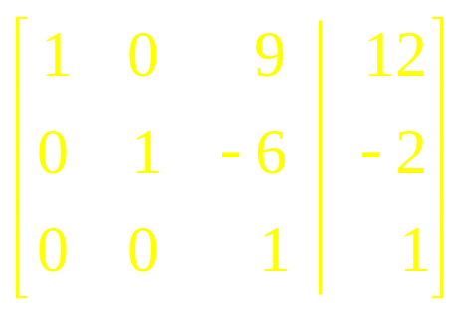


Example
Use the Gauss-Jordan elimination method to solve the system of equations
Solution
Toggle slides back and forth to compare before and after matrix changes
NM Dr P V Ramana

Slide 47
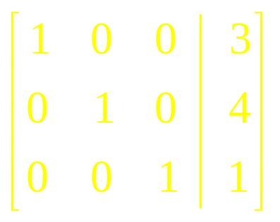
Example
Use the Gauss-Jordan elimination method to solve the system of equations
Solution
Toggle slides back and forth to compare before and after matrix changes
NM Dr P V Ramana

Slide 48
Example
Use the Gauss-Jordan elimination method to solve the system of equations
Solution
The solution to the system is thus x = 3, y = 4, and z = 1.
NM Dr P V Ramana

Slide 49
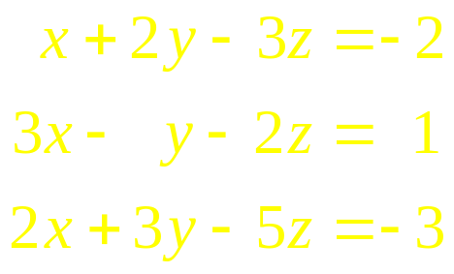
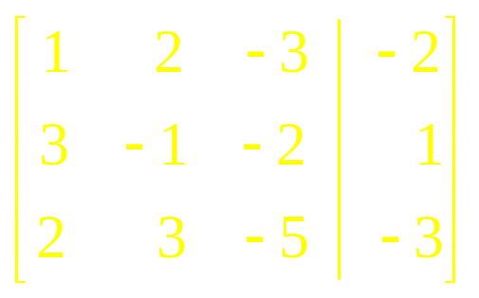
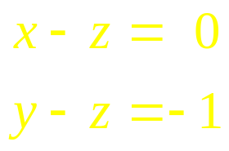
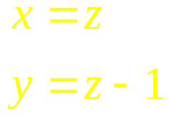
Systems of Linear Equations:
Underdetermined and Overdetermined systems
NM Dr P V Ramana

Slide 50


A System of Equations with an Infinite Number of Solutions
Solve the system of equations given by
Solution
Toggle slides back and forth to compare before and after matrix changes
NM Dr P V Ramana

Slide 51
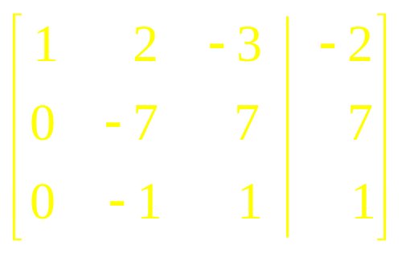

A System of Equations with an Infinite Number of Solutions
Solve the system of equations given by
Solution
Toggle slides back and forth to compare before and after matrix changes
NM Dr P V Ramana

Slide 52
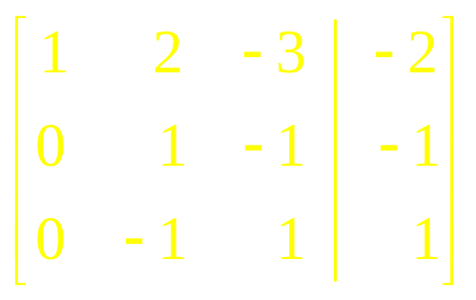


A System of Equations with an Infinite Number of Solutions
Solve the system of equations given by
Solution
Toggle slides back and forth to compare before and after matrix changes
NM Dr P V Ramana

Slide 53
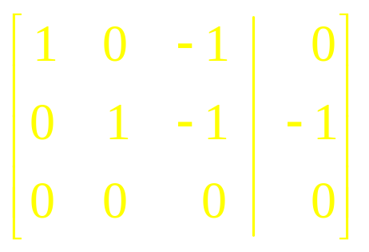
A System of Equations with an Infinite Number of Solutions
Solve the system of equations given by
Solution
Toggle slides back and forth to compare before and after matrix changes
NM Dr P V Ramana

Slide 54
A System of Equations with an Infinite Number of Solutions
Solve the system of equations given by
Solution
Observe that row three reads 0 = 0, which is true but of no use to us.
NM Dr P V Ramana

Slide 55
A System of Equations with an Infinite Number of Solutions
Solve the system of equations given by
Solution
This last augmented matrix is in row-reduced form.
Interpreting it as a system of equations gives a system of two equations in three variables x, y, and z:
NM Dr P V Ramana

Slide 56
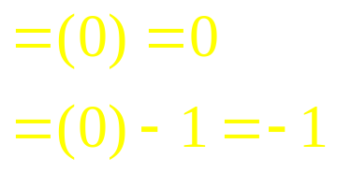
A System of Equations with an Infinite Number of Solutions
Solve the system of equations given by
Solution
Let’s single out a single variable – say, z – and solve for x and y in terms of it.
If assign a particular value of z – say, z = 0 – obtain x = 0 and y = –1, giving the solution (0, –1, 0).
NM Dr P V Ramana

Slide 57
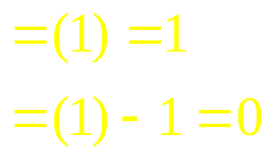
A System of Equations with an Infinite Number of Solutions
Solve the system of equations given by
Solution
Let’s single out a single variable – say, z – and solve for x and y in terms of it.
If instead assign z = 1, obtain the solution (1, 0, 1).
NM Dr P V Ramana

Slide 58
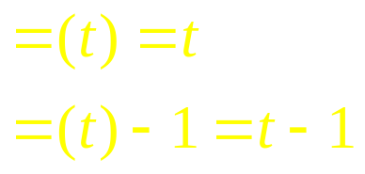
A System of Equations with an Infinite Number of Solutions
Solve the system of equations given by
Solution
Let’s single out a single variable – say, z – and solve for x and y in terms of it.
In general, set z = t, where t represents any real number (called the parameter) to obtain the solution (t, t – 1, t).
NM Dr P V Ramana

Slide 59
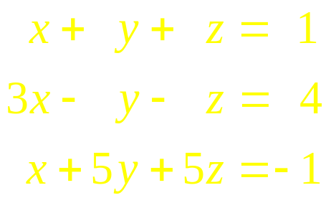
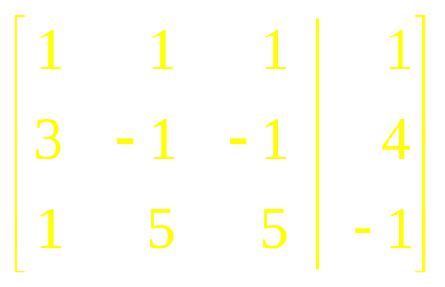

A System of Equations That Has No Solution
Solve the system of equations given by
Solution
Toggle slides back and forth to compare before and after matrix changes
NM Dr P V Ramana

Slide 60
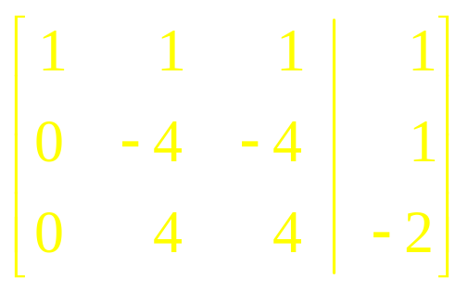
A System of Equations That Has No Solution
Solve the system of equations given by
Solution
Toggle slides back and forth to compare before and after matrix changes
NM Dr P V Ramana

Slide 61
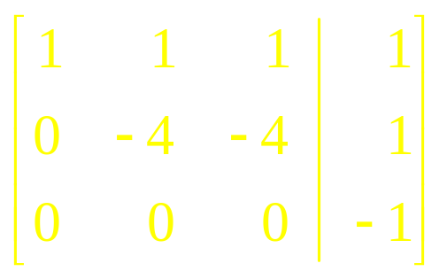
A System of Equations That Has No Solution
Solve the system of equations given by
Solution
Toggle slides back and forth to compare before and after matrix changes
NM Dr P V Ramana

Slide 62
A System of Equations That Has No Solution
Solve the system of equations given by
Solution
Observe that row three reads 0x + 0y + 0z = –1 or 0 = –1!
therefore conclude the system is inconsistent and has no solution.
NM Dr P V Ramana

Slide 63
Systems with no Solution
If there is a row in the augmented matrix containing all zeros to the left of the vertical line and a nonzero entry to the right of the line, then the system of equations has no solution.
NM Dr P V Ramana

Slide 64
Theorem 1
If the number of equations is greater than or equal to the number of variables in a linear system, then one of the following is true:
  The system has no solution.
  The system has exactly one solution.
  The system has infinitely many solutions.
If there are fewer equations than variables in a linear system, then the system either has no solution or it has infinitely many solutions.
NM Dr P V Ramana

Slide 65
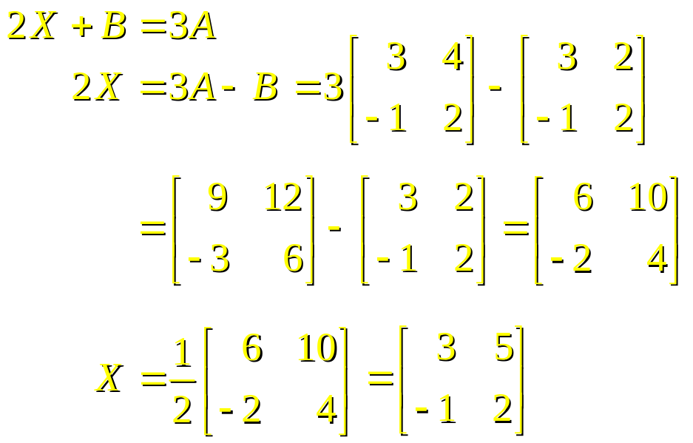
Matrices
NM Dr P V Ramana

Slide 66
Matrix
A matrix is an ordered rectangular array of numbers.
A matrix with m rows and n columns has size m ☓ n.
The entry in the ith row and jth column is denoted by a_{ij}.
NM Dr P V Ramana

Slide 67
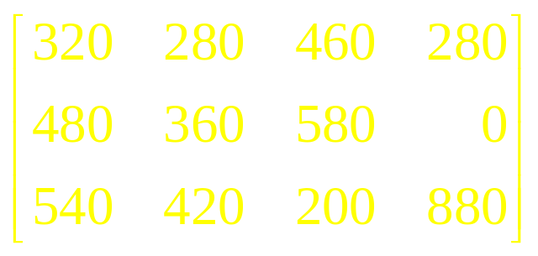
Applied Example: Organizing Production Data
The Acrosonic Company manufactures four different loudspeaker systems at three separate locations.
The company’s May output is as follows:
If agree to preserve the relative location of each entry in the table, can summarize the set of data as follows:
 | Model A | Model B | Model C | Model D
Location I | 320 | 280 | 460 | 280
Location II | 480 | 360 | 580 | 0
Location III | 540 | 420 | 200 | 880
NM Dr P V Ramana

Slide 68

Applied Example: Organizing Production Data
have Acrosonic’s May output expressed as a matrix:
  What is the size of the matrix P?
  Solution
  Matrix P has three rows and four columns and hence has size 3 ☓ 4.
NM Dr P V Ramana

Slide 69
Applied Example: Organizing Production Data
have Acrosonic’s May output expressed as a matrix:
  Find a₂₄ (the entry in row 2 and column 4 of the matrix P) and give an interpretation of this number.
  Solution
  The required entry lies in row 2 and column 4, and is the number 0. This means that no model D loudspeaker system was manufactured at location II in May.
NM Dr P V Ramana

Slide 70
Applied Example: Organizing Production Data
have Acrosonic’s May output expressed as a matrix:
  Find the sum of the entries that make up row 1 of P and interpret the result.
  Solution
  The required sum is given by
  320 + 280 + 460 + 280 = 1340
  which gives the total number of loudspeaker systems manufactured at location I in May as 1340 units.
NM Dr P V Ramana

Slide 71
Applied Example: Organizing Production Data
Have Acrosonic’s May output expressed as a matrix:
  Find the sum of the entries that make up column 4 of P and interpret the result.
  Solution
  The required sum is given by
  280 + 0 + 880 = 1160
  giving the output of Model D loudspeaker systems at all locations in May as 1160 units.
NM Dr P V Ramana

Slide 72
Equality of Matrices
Two matrices are equal if they have the same size and their corresponding entries are equal.
NM Dr P V Ramana

Slide 73

Example
Solve the following matrix equation for x, y, and z:
Solution
Since the corresponding elements of the two matrices must be equal, find that x = 4, z = 3, and y – 1 = 1, or y = 2.
NM Dr P V Ramana

Slide 74
Addition and Subtraction of Matrices
If A and B are two matrices of the same size, then:
  The sum A + B is the matrix obtained by adding the corresponding entries in the two matrices.
  The difference A – B is the matrix obtained by subtracting the corresponding entries in B from those in A.
NM Dr P V Ramana

Slide 75
Applied Example: Organizing Production Data
The total output of Acrosonic for May is
The total output of Acrosonic for June is
Find the total output of the company for May and June.
 | Model A | Model B | Model C | Model D
Location I | 320 | 280 | 460 | 280
Location II | 480 | 360 | 580 | 0
Location III | 540 | 420 | 200 | 880
 | Model A | Model B | Model C | Model D
Location I | 210 | 180 | 330 | 180
Location II | 400 | 300 | 450 | 40
Location III | 420 | 280 | 180 | 740
NM Dr P V Ramana

Slide 76


Applied Example: Organizing Production Data
Solution
Expressing the output for May and June as matrices:
  The total output of Acrosonic for May is
  The total output of Acrosonic for June is
NM Dr P V Ramana

Slide 77

Applied Example: Organizing Production Data
Solution
The total output of the company for May and June is given by the matrix
NM Dr P V Ramana

Slide 78
Laws for Matrix Addition
If A, B, and C are matrices of the same size, then
  A + B = B + A Commutative law
  (A + B) + C = A + (B + C) Associative law
NM Dr P V Ramana

Slide 79
Transpose of a Matrix
If A is an m ☓ n matrix with elements a_{ij}, then the transpose of A is the n ☓ m matrix A^{T} with elements a_{ji}.
NM Dr P V Ramana

Slide 80


Example
Find the transpose of the matrix
Solution
The transpose of the matrix A is
NM Dr P V Ramana

Slide 81
Scalar Product
If A is a matrix and c is a real number, then the scalar product cA is the matrix obtained by multiplying each entry of A by c.
NM Dr P V Ramana

Slide 82







Example
Given
find the matrix X that satisfies 2X + B = 3A
Solution
NM Dr P V Ramana

Slide 83
Applied Example: Production Planning
The management of Acrosonic has decided to increase its July production of loudspeaker systems by 10% (over June output).
Find a matrix giving the targeted production for July.
Solution
have seen that Acrosonic’s total output for June may be represented by the matrix
NM Dr P V Ramana

Slide 84


Applied Example: Production Planning
The management of Acrosonic has decided to increase its July production of loudspeaker systems by 10% (over June output).
Find a matrix giving the targeted production for July.
Solution
The required matrix is given by
NM Dr P V Ramana

Slide 85

Multiplication of Matrices
NM Dr P V Ramana

Slide 86



Multiplying a Row Matrix by a Column Matrix
If have a row matrix of size 1☓ n,
And a column matrix of size n ☓ 1,
Then may define the matrix product of A and B, written AB, by
NM Dr P V Ramana

Slide 87


Example
Let
Find the matrix product AB.
Solution
NM Dr P V Ramana

Slide 88
Dimensions Requirement for Matrices Being Multiplied
Note from the last example that for the multiplication to be feasible, the number of columns of the row matrix A must be equal to the number of rows of the column matrix B.
NM Dr P V Ramana

Slide 89
Dimensions of the Product Matrix
From last example, note that the product matrix AB has size 1 ☓ 1.
This has to do with the fact that are multiplying a row matrix with a column matrix.
can establish the dimensions of a product matrix schematically:
Size of AB
(1 ☓ 1)
Size of A (1 ☓ n)
(n ☓ 1) Size of B
Same
NM Dr P V Ramana

Slide 90
Dimensions of the Product Matrix
More generally, if A is a matrix of size m ☓ n and B is a matrix of size n ☓ p, then the matrix product of A and B, AB, is defined and is a matrix of size m ☓ p.
Schematically:
The number of columns of A must be the same as the number of rows of B for the multiplication to be feasible.
Size of AB
(m ☓ p)
Size of A (m ☓ n)
(n ☓ p) Size of B
Same
NM Dr P V Ramana

Slide 91

Mechanics of Matrix Multiplication
To see how to compute the product of a 2 ☓ 3 matrix A and a 3 ☓ 4 matrix B, suppose
From the schematic
see that the matrix product C = AB is feasible (since the number of columns of A equals the number of rows of B) and has size 2 ☓ 4.
Size of AB
(2 ☓ 4)
Size of A (2 ☓ 3)
(3 ☓ 4) Size of B
Same
NM Dr P V Ramana

Slide 92


Mechanics of Matrix Multiplication
To see how to compute the product of a 2 ☓ 3 matrix A and a 3 ☓ 4 matrix B, suppose
Thus,
To see how to calculate the entries of C consider entry c₁₁:
NM Dr P V Ramana

Slide 93

Mechanics of Matrix Multiplication
To see how to compute the product of a 2 ☓ 3 matrix A and a 3 ☓ 4 matrix B, suppose
Thus,
Now consider calculating the entry c₁₂:
NM Dr P V Ramana

Slide 94

Mechanics of Matrix Multiplication
To see how to compute the product of a 2 ☓ 3 matrix A and a 3 ☓ 4 matrix B, suppose
Thus,
Now consider calculating the entry c₂₁:
NM Dr P V Ramana

Slide 95
Mechanics of Matrix Multiplication
To see how to compute the product of a 2 ☓ 3 matrix A and a 3 ☓ 4 matrix B, suppose
Thus,
Other entries are computed in a similar manner.
NM Dr P V Ramana

Slide 96

Example
Let
Compute AB.
Solution
Since the number of columns of A is equal to the number of rows of B, the matrix product C = AB is defined.
The size of C is 2 ☓ 3.
NM Dr P V Ramana

Slide 97


Example
Let
Compute AB.
Solution
Thus,
Calculate all entries for C:
NM Dr P V Ramana

Slide 98


Example
Let
Compute AB.
Solution
Thus,
Calculate all entries for C:
NM Dr P V Ramana

Slide 99


Example
Let
Compute AB.
Solution
Thus,
Calculate all entries for C:
NM Dr P V Ramana

Slide 100


Example
Let
Compute AB.
Solution
Thus,
Calculate all entries for C:
NM Dr P V Ramana

Slide 101


Example
Let
Compute AB.
Solution
Thus,
Calculate all entries for C:
NM Dr P V Ramana

Slide 102


Example
Let
Compute AB.
Solution
Thus,
Calculate all entries for C:
NM Dr P V Ramana

Slide 103

Example
Let
Compute AB.
Solution
Thus,
NM Dr P V Ramana

Slide 104
Laws for Matrix Multiplication
If the products and sums are defined for the matrices A, B, and C, then
  (AB)C = A(BC) Associative law
  A(B + C) = AB + AC Distributive law
NM Dr P V Ramana

Slide 105

Identity Matrix
The identity matrix of size n is given by
n rows
n columns
NM Dr P V Ramana

Slide 106

Properties of the Identity Matrix
The identity matrix has the properties that
  I_{n} A = A for any n ☓ r matrix A.
  BI_{n} = B for any s ☓ n matrix B.
  In particular, if A is a square matrix of size n, then
NM Dr P V Ramana

Slide 107



Example
Let
Then
So, I₃A = AI₃ = A.
NM Dr P V Ramana

Slide 108


Matrix Representation
A system of linear equations can be expressed in the form of an equation of matrices. Consider the system
The coefficients on the left-hand side of the equation can be expressed as matrix A below, the variables as matrix X, and the constants on right-hand side of the equation as matrix B:
NM Dr P V Ramana

Slide 109

Matrix Representation
A system of linear equations can be expressed in the form of an equation of matrices. Consider the system
The matrix representation of the system of linear equations is given by AX = B, or
NM Dr P V Ramana

Slide 110

Matrix Representation
A system of linear equations can be expressed in the form of an equation of matrices. Consider the system
To confirm this, can multiply the two matrices on the left-hand side of the equation, obtaining
which, by matrix equality, is easily seen to be equivalent to the given system of linear equations.
NM Dr P V Ramana

Slide 111

5.6
The Inverse of a Square Matrix
NM Dr P V Ramana

Slide 112

Inverse of a Matrix
Let A be a square matrix of size n.
A square matrix A^{–1} of size n such that
is called the inverse of A.
Not every matrix has an inverse.
  A square matrix that has an inverse is said to be nonsingular.
  A square matrix that does not have an inverse is said to be singular.
NM Dr P V Ramana

Slide 113




Example: A Nonsingular Matrix
The matrix has a matrix
as its inverse.
This can be demonstrated by multiplying them:
NM Dr P V Ramana

Slide 114



Example: A Singular Matrix
The matrix does not have an inverse.
If B had an inverse given by where
a, b, c, and d are some appropriate numbers, then by definition of an inverse would have BB^{–1} = I.
That is
implying that 0 = 1, which is impossible!
NM Dr P V Ramana

Slide 115
Finding the Inverse of a Square Matrix
Given the n ☓ n matrix A:
  Adjoin the n ☓ n identity matrix I to obtain the augmented matrix [A | I ].
  Use a sequence of row operations to reduce [A | I ] to the form [I | B] if possible.
Then the matrix B is the inverse of A.
NM Dr P V Ramana

Slide 116


Example
Find the inverse of the matrix
Solution
form the augmented matrix
NM Dr P V Ramana

Slide 117

Example
Find the inverse of the matrix
Solution
And use the Gauss-Jordan elimination method to reduce it to the form [I | B]:
Toggle slides back and forth to compare before and changes
NM Dr P V Ramana

Slide 118


Example
Find the inverse of the matrix
Solution
And use the Gauss-Jordan elimination method to reduce it to the form [I | B]:
Toggle slides back and forth to compare before and changes
NM Dr P V Ramana

Slide 119


Example
Find the inverse of the matrix
Solution
And use the Gauss-Jordan elimination method to reduce it to the form [I | B]:
Toggle slides back and forth to compare before and changes
NM Dr P V Ramana

Slide 120


Example
Find the inverse of the matrix
Solution
And use the Gauss-Jordan elimination method to reduce it to the form [I | B]:
Toggle slides back and forth to compare before and changes
NM Dr P V Ramana

Slide 121

Example
Find the inverse of the matrix
Solution
And use the Gauss-Jordan elimination method to reduce it to the form [I | B]:
Toggle slides back and forth to compare before and changes
I_{n}
B
NM Dr P V Ramana

Slide 122


Example
Find the inverse of the matrix
Solution
Thus, the inverse of A is the matrix
NM Dr P V Ramana

Slide 123


A Formula for the Inverse of a 2 ☓ 2 Matrix
Let
Suppose D = ad – bc is not equal to zero.
Then A^{–1} exists and is given by
NM Dr P V Ramana

Slide 124
Example
Find the inverse of
Solution
first identify a, b, c, and d as being 1, 2, 3, and 4 respectively.
then compute
D = ad – bc = (1)(4) – (2)(3) = 4 – 6 = – 2
NM Dr P V Ramana

Slide 125


Example
Find the inverse of
Solution
Next, substitute the values 1, 2, 3, and 4 instead of a, b, c, and d, respectively, in the formula matrix
to obtain the matrix
NM Dr P V Ramana

Slide 126

Example
Find the inverse of
Solution
Finally, multiplying this matrix by 1/D, obtain
NM Dr P V Ramana

Slide 127
Using Inverses to Solve Systems of Equations
If AX = B is a linear system of n equations in n unknowns and if A^{–1} exists, then
X = A^{–1}B
is the unique solution of the system.
NM Dr P V Ramana

Slide 128


Example
Solve the system of linear equations
Solution
Write the system of equations in the form AX = B where
NM Dr P V Ramana

Slide 129

Example
Solve the system of linear equations
Solution
Find the inverse matrix of A:
NM Dr P V Ramana

Slide 130


Example
Solve the system of linear equations
Solution
Finally, write the matrix equation X = A^{–1}B and multiply:
NM Dr P V Ramana

Slide 131

Example
Solve the system of linear equations
Solution
Finally, write the matrix equation X = A^{–1}B and multiply:
Thus, the solution is x = 2, y = –1, and z = –2.
NM Dr P V Ramana

Slide 132

NM Dr P V Ramana

